Slide 1


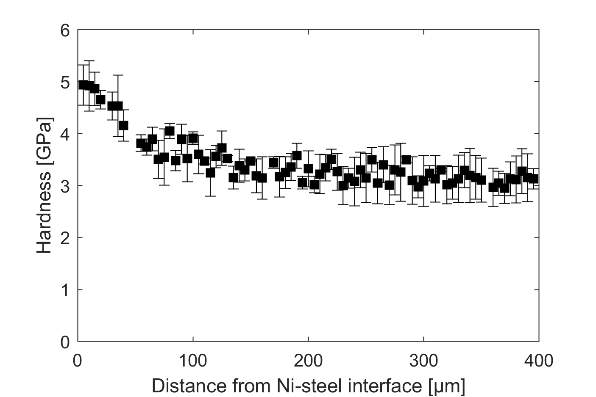
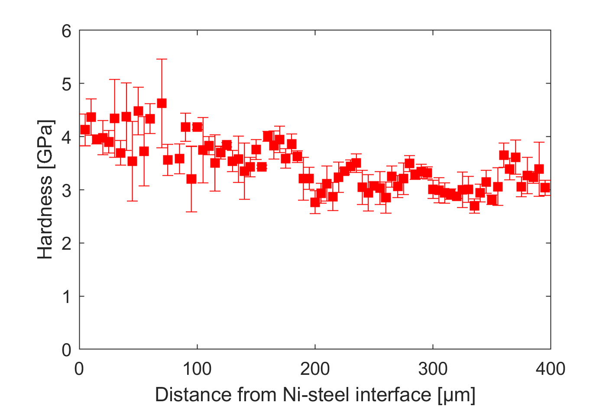
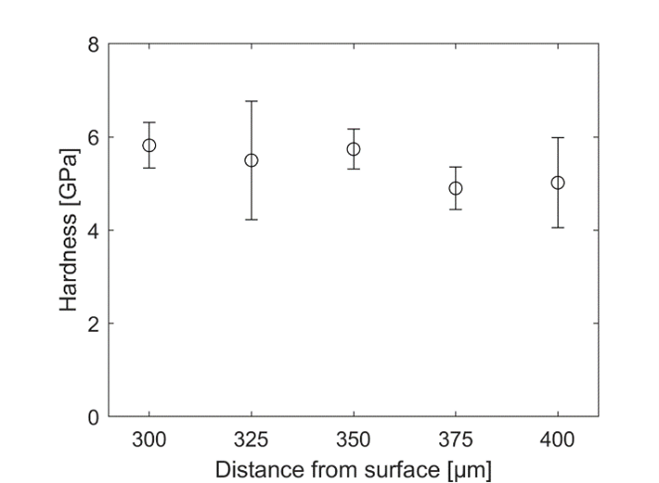
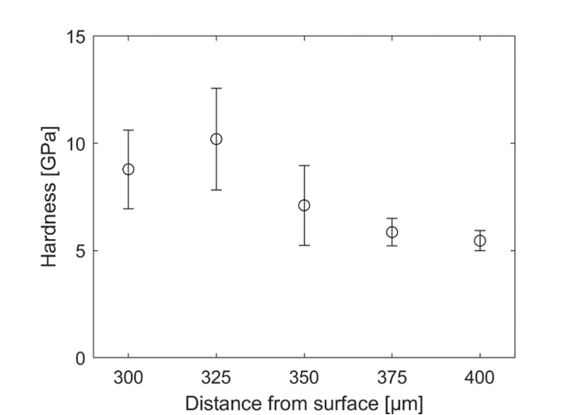
Surface and Near Surface Characterization of Mechanical and Chemical Properties
C03/Nanoindentierung – Prof. Dr. Dr. h. c. Don A. Lucca
Objective and approach
The goal of this sub‐project is to explore the resulting changes in both the mechanical and chemical state of the surface and near surface of workpieces caused by various machining processes. This information will provide a component to the process signature which will be developed. For the mechanical characterizations of the 42CrMo4 surfaces, nanoindentation will be used to measure hardness and elastic modulus. Nanoindentation was performed on cross‐sectioned or taper‐sectioned workpieces. This allowed for depth profiles of the hardness and elastic modulus to be obtained. Raman spectroscopy was applied to investigate shifts in the chemical state and Rutherford back scattering spectrometry was used to investigate the resulting lattice disorder and depth of subsurface damage.
Current state of knowledge
The near surface modification of 42CrMo4 steel subjected to orthogonal cutting was investigated in collaboration with sub project C02. Nanoindentation experiments were performed on the taper section using a commercial nanoindenter. A diamond Berkovich indenter was used with a maximum load of 5 mN and a five-segment loading and unloading curve. The measured hardness is shown in the top figures, as a function of distance along the tapered section from the Ni coating.
The near surface modification of 42CrMo4 steel modified by laser-chemical machining (LCM) was investigated in collaboration with sub project F07.
Nanoindentation experiments were performed on two cross-sections between the depth of 300 µm and 400 µm. The measured hardness is shown in the bottom figures, as a function of distance from the machined surface.
Other 42CrMo4 specimens were investigated, but the surface roughness was too high for the nanoindentation measurements to be effective.
Hardness values measured by nanoindentation on the taper sectioned ferrite-perlite specimens with h=50 µm, vc=150 m/min (left) and h=200 µm, vc=50 m/min (right).
Hardness values measured by nanoindentation on the cross-sectioned 42CrMo4 specimens P8AAN1(left) and P8AAN5 (right).
Conclusion and further procedure
The findings show that the approach with the taper section preparation is expedient for 42CrMo4 steel subjected to orthogonal cutting. The hardness increased where the grain size decreased, as shown by EBDS experiments.
For the specimen produced by laser-chemical machining, the hardness showed a higher value toward the surface.
Publications
Qi, Y.; Shojaee, S.A.; Harriman, T.A.; Wang, Y.Q.; Mehner, A.; Lucca, D.A.: Effects of nuclear and electronic stopping powers on the conversion of hybrid silicate thin films. Nuclear Instruments and Methods in Physics Research B 444 (2019) 103–106.
Zare, A.; Su, Q.; Gigax, J.; Harriman, T.A.; Nastasi, M.; Shao, L.; Lucca, D.A.: Mechanical Response of He-Implanted Amorphous SiOC/Crystalline Fe Nanolaminates. Scientific Reports 9 (2019) 4759.
Zare, A.; Su, Q.; Gigax, J.; Shojaee, S.A.; Harriman, T.A.; Nastasi, M.; Shao, L.; Materer, N.F.; Lucca, D.A.: Effects of ion irradiation on chemical and mechanical properties of magnetron sputtered amorphous SiOC. Nuclear Instruments and Methods in Physics Research B 446 (2019) 10–14.
Harriman, T.A.; Lee, J.K.; Sung, G.Y.; Lucca, D.A.: Photoluminescence of cerium doped Si nanocrystals embedded in silicon nitride films. Physica Status Solidi (B) 256 (2019) 1800706.

